Slide 1
ONE PERSON IN GROUP-> CLICK USE TEMPLATE
WHEN THE COPIED TEMPLATE OF THESE SLIDES OPENS IN A NEW TAB:
ADD YOUR Group NAME TO THE TITLE
SHARE WITH GROUP MEMBERS (USE SHARE BUTTON)
COPY THE TITLE AND LINK TO YOUR RECORDS (Digital folder/table of contents)
Remember it is advisable to make a PERSONAL copy and link it when DONE

Slide 2
Concentration & Molarity

Slide 3
ESSENTIAL QUESTIONS
Remember, you should be able to thoroughly answer these AFTER learning through following resources.
How are concentrations calculated?
What are the different ways that concentration can be represented (m/m,v/v,m/v)?
What are the different ways that very small concentrations can be represented (ppm, ppb)?
How are concentrations for reactions represented (M, mol/L)?

Slide 4
Instructions
Follow through the Engage to Apply resources in order .
Once complete, choose from Extend resources as interested.
Record your learning in your these slides- Remember to keep track of where to find these slides for studying!
Complete the Essential Questions Response in the Apply Section.
Try the Extend section and optional Apply practice as desired to deepen your understanding

Slide 5
Hyperdoc Elements
Click for quick access to:
Engage
Explore
Explain
Apply
Extend

Slide 6
Terminology - As you encounter terms new to you, define in your own words here, include examples (make them up!)

Slide 7
Part 1: ENGAGE

Slide 8
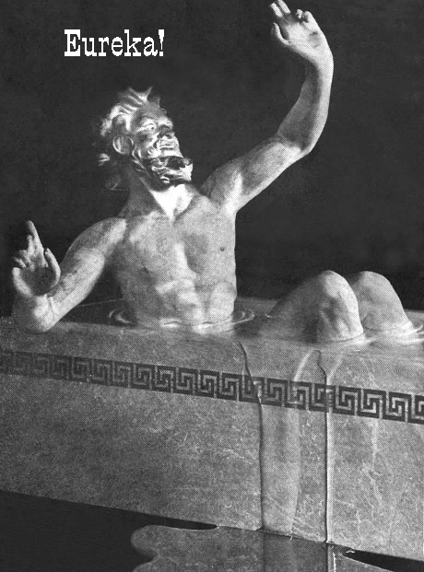
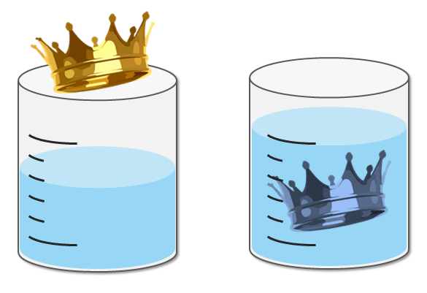
Explore - Part A: 5 minutes
There is a famous story with Archimedes:
A local tyrant, Hiero, contracts the ancient Greek polymath Archimedes to detect fraud in the manufacture of a golden crown because he suspects his goldsmith replaced some of the gold in his crown and replaced it with silver. Archimedes accepts the challenge and, during a subsequent trip to the public baths, realizes that the more his body sinks into the water, the more water is displaced--making the displaced water an exact measure of his volume. Because gold weighs more than silver, he reasons that a crown mixed with silver would have to be bulkier to reach the same weight as one composed only of gold; therefore it would displace more water than its pure gold counterpart. Realizing he has hit upon a solution, he leapt out of the bath and rushed home naked crying "Eureka! Eureka!" Or, translated: "I've found it! I've found it!"
Discuss with your group: How might the concept of moles be applied to the scenario of ‘how much’ of something there is in a given volume? In what other parts of your life is idea of the ‘amount of stuff’ in a given volume relevant? Make a list!
Notes:
https://www.scientificamerican.com/article/fact-or-fiction-archimede/

Slide 9
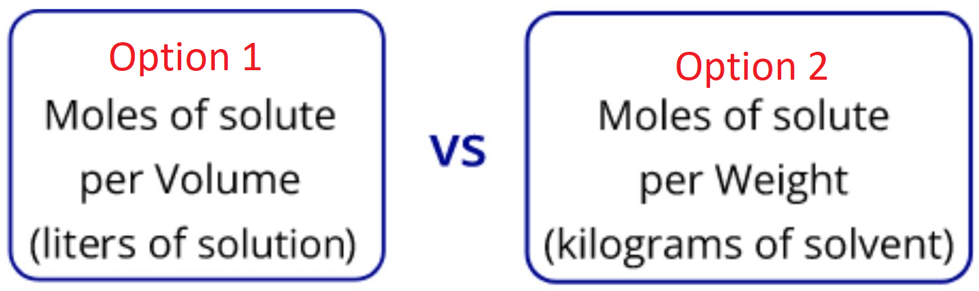
Explore - Part B: 5 minutes
In your groups,discuss the advantages and disadvantages for representing concentrations with the two ways above. (hint: think about accuracy, usability, the impacts of temperature [like we learned with solubility], impacts of pressure, solute state of matter etc)
Give as many ideas as you can, correct or not! (don’t self edit!)
Notes:
Molality vs molarity

Slide 10
Part 2: EXPLORE

Slide 11
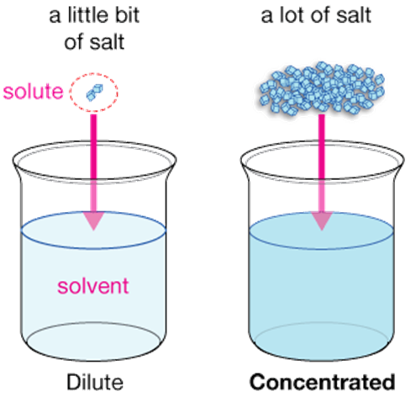
Explore - What is concentration?
One way to describe solutions (qualitatively) is with the following terms:
➢Concentrated: high ratio of solute to solvent
○ie. lots of solute in the solvent
➢Dilute: low ratio of solute to solvent
○ie. small amount of solute in the solvent

Slide 12
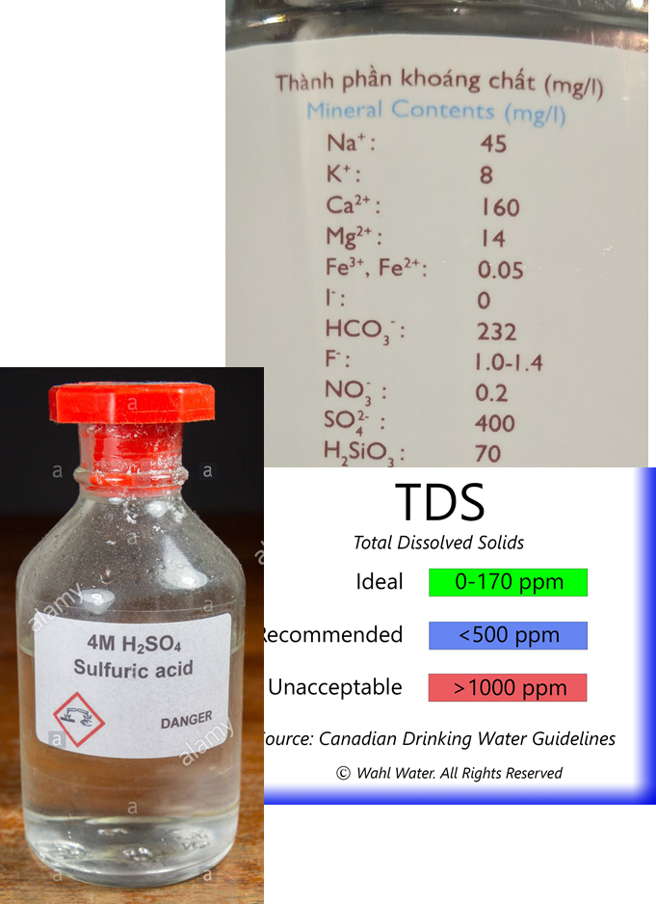
Explore - Quantifying Concentration
We can also quantify (put a number to) Concentration
This can take many forms:
➢Percent concentrations (v/v, m/v, m/m)
➢Parts per mass (ppm, ppb)
➢Molar concentration (mol/L or M)
Most used in science

Slide 13
Explore - Percent Concentration
Percent Concentrations - ratio of solute to solvent, expressed as a percentage.
1.Mass Percent (m/m%)
➢ratio of the mass of the solute to the mass of the solution
2.Volume Percent (v/v%)
➢ratio of the volume of the solute to the volume of the solution
3.Mass/Volume Percent (m/v%)
➢ratio of the mass of the solute to the volume of the solution
The choice of which one is based on the units (mass or volume) you have!

Slide 14
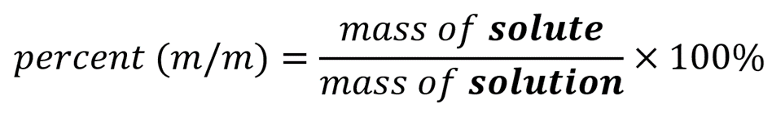
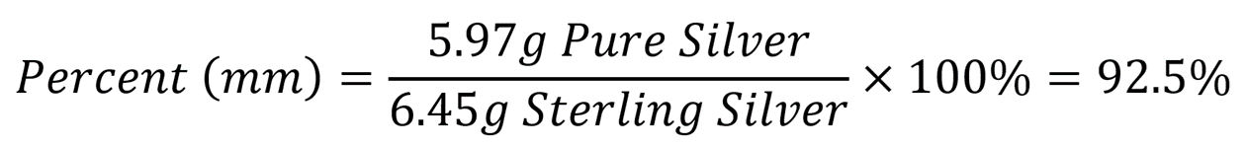
Explore - Calculating Mass Percent
**Units must be same for both**
Example: A 6.45g Sterling Silver ring contains 5.97g of pure Silver. Calculate the Mass Percent of pure Silver in the ring.

Slide 15
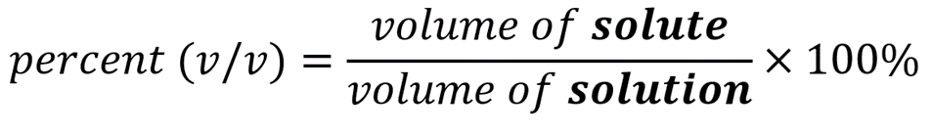
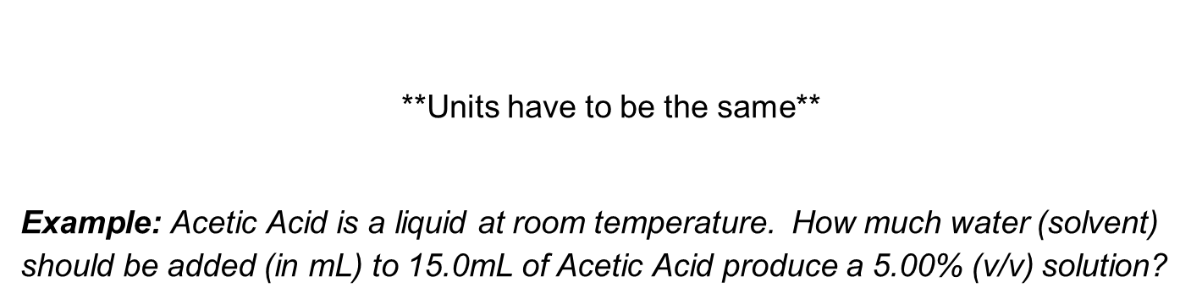
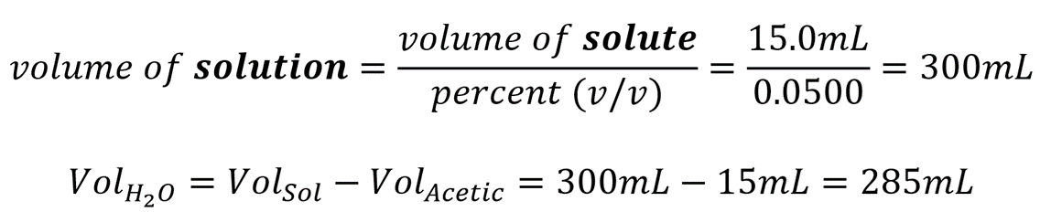
Explore - Calculating Volume Percent

Slide 16
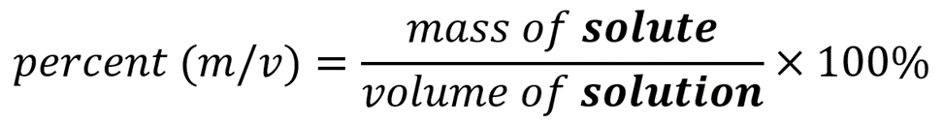
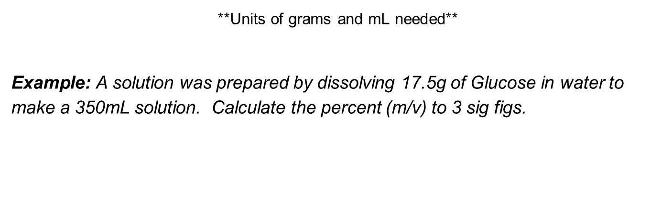
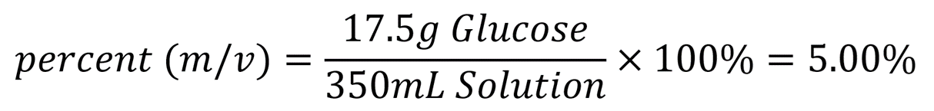
Explore - Calculating Percent Mass by Volume

Slide 17
Explore - Measuring Small Concentrations
Sometimes even very small concentrations are important to know. (such as 0.0000001% m/m). So we have more useful units:
➢Parts per Million (ppm)
○ Ratio (by mass) of how many parts of solute there are per every million parts of the solution
➢Parts per Billion (ppb)
○Ratio (by mass) of how many parts of solute there are per every billion parts of the solution

Slide 18
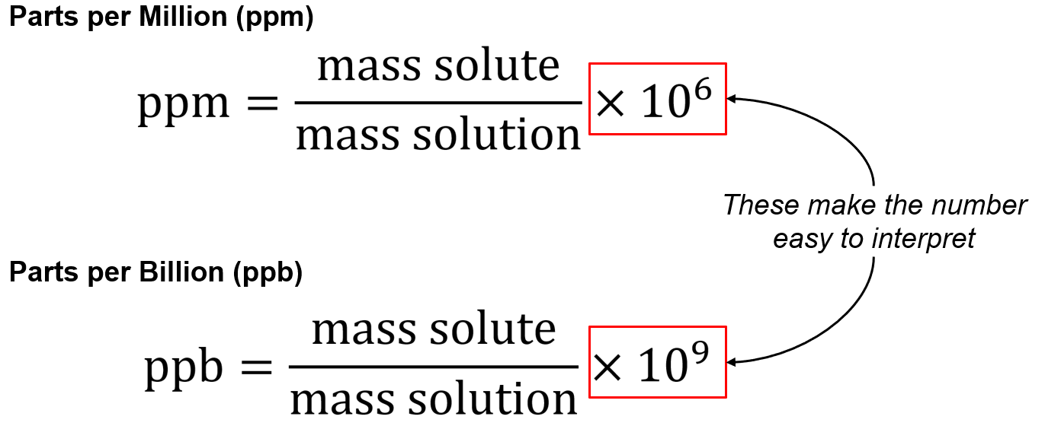
Explore - Calculating ppm & ppb
Masses must be in the SAME UNIT (Both in grams is easiest)!!

Slide 19
Explore - Real Life: Lead in Water
The World Health Organization says ~100 ppb lead in human blood is toxic
➢It can cause cancer, and developmental delays in children
Canada regulation - max 5 ppb for lead in drinking water
US regulation - max 15 ppb for lead in drinking water
➢regulation - max 50 ppb for lead in river water
This means that safe river water can still have 3x more lead than the limit for safe drinking water

Slide 20
Explore - Calculating ppm & ppb
IN YOUR GROUP - WORK AT A CLASS WHITEBOARD on these two slides
Record your work (take a photo and insert in these slides, redraw it in your notes etc)
1. Health Canada’s guideline for maximum Mercury in fish is 0.5ppm. When a 1.6kg salmon was tested, it was found to contain 0.6mg of Mercury. Is this salmon safe to eat? Tip: convert the units to match!
Answer slides at the bottom of slide deck.

Slide 21
Explore - Calculating ppm & ppb
IN YOUR GROUP - WORK AT A CLASS WHITEBOARD
Record your work (take a photo and insert in these slides, redraw it in your notes etc)
2. In Ontario, drinking water should have less than 10 ppb of lead in it. What is the maximum amount of lead allowed in a 500 mL bottle of water?
1mL of water = 1g of water (using density)
Therefore 10ppb = 10g in 1,000,000,000g of water
Set up equivalent Ratios using this data to answer the question!
Answer slides at the bottom of slide deck.

Slide 22
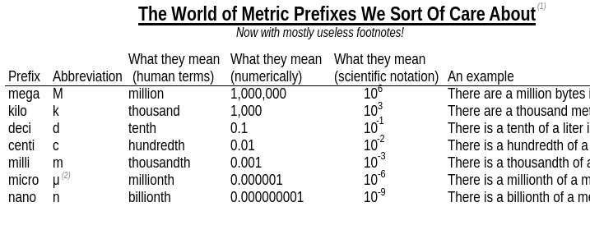
Know your prefixes! See the table below.

Slide 23
Concentration Activity
Ask for the Concentration Activity Sheet and visit the stations to complete.

Slide 24
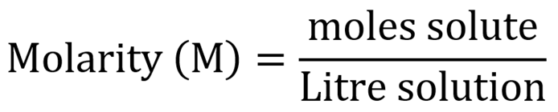
Explore - Molar Concentration
Most useful way to measure concentrations in Chemistry is moles per volume
➢Remember it is easy to transfer moles, mass, and particles!
Molar Concentration is the moles of solute per Litre of solution
➢The units for this are mol/L or Molarity (M)
➢[ ] is also used for concentration
Ex: [CuCl₂] = 2M, means the concentration of CuCl₂ is 2 moles per L

Slide 25
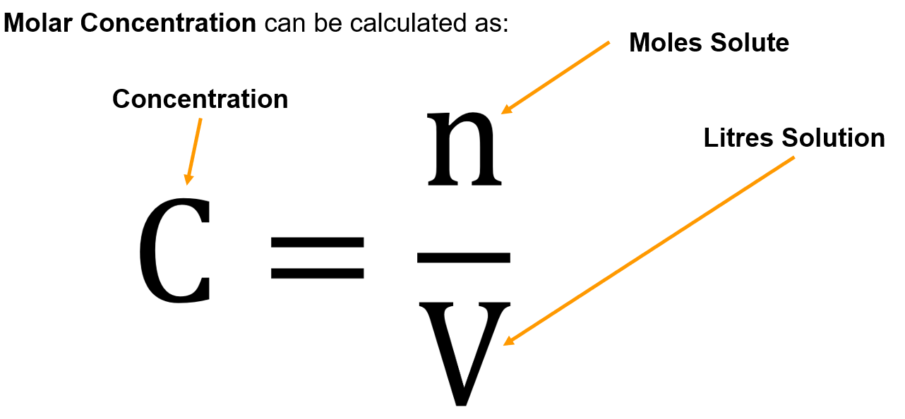
Explore - Calculating Molar Concentration

Slide 26
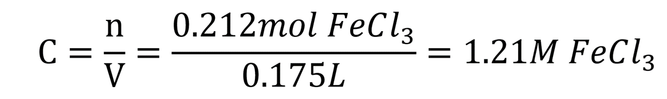

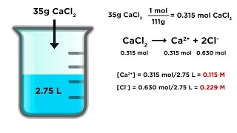
Explore - Molarity Practice
A student dissolves 0.212mol of FeCl₃ to make a 175mL solution. a) Calculate the concentration of the solution b) Calculate the concentration of chloride ions in solution
a)
b) Fe : Cl
1 : 3
1.21 : x
x = (1.21)(3) = 3.63 M Cl⁻

Slide 27
Explore - Mass to Molarity Practice
A student dissolves 29.43g of NaOH into 500mL of distilled water. What is the molar concentration of NaOH in the solution?
Determine Moles:
MM_{NaOH} = 22.99 + 16 + 1.01 = 40
n = m/MM
n = 29.43 / 40
n = 0.73575 mol
500mL = 0.5 L
Using moles, determine Concentration:
C = n/V
C = 0.73575 / 0.5
C = 1.47 M
∴ the concentration of NaOH is 1.47M

Slide 28
Explore - Molarity to Mass Practice
Normal saline solution for rehydration in hospitals contains 0.154M NaCl. Calculate the mass of NaCl present in 500mL of solution.
Concentration:
500mL = 0.5 L
C = n/V
0.154 = n / 0.5L
n = 0.077 mol
Mass:
MM_{NaCl} = 22.99 + 35.45 = 58.44
n = m/MM
0.077 = m / 58.44
n = 4.50 g
∴ the mass of NaCl in solution is 4.50 g

Slide 29

Explore - Molarity
{Optional} For further help you can watch this video

Slide 30
Part 3: Apply

Slide 31

Apply- Complete the questions
Show all your work! Include formulas, conversions, units, etc.
(m/v)%: 45g of Cobalt Chloride is dissolved in 231mL of water. What is the (m/V)% Concentration of the solution?
(m/m)%: Bronze medals in the 2018 PyeongChang Olympics had a mass of 493g. If each bronze medal contained about 435g of Copper, what is the (m/m)% of Copper in the bronze medal?
(v/v)%: A 300mL bottle of wine contains 35mL of alcohol. What is the (v/v)%
(v/v)%: A water sample is taken from a river to test for pollution. It must be diluted to 2% by volume of its original amount. If you have a 30mL sample, how much water must you add to get to this desired concentration?
ppm/ppb: 3mg of a dangerous chemical is found In 300 L of water. What is its concentration in ppm?

Slide 32
Apply- Complete the questions
Work at the board for the next few slides. Insert photos of your work and compare to answers after attempting. Show all your work! Include formulas, conversions, units, etc.
How many moles of sucrose are dissolved in 250 mL of solution if the solution concentration is 0.150 M?

Slide 33
Apply- Complete the questions
Work at the board for the next few slides. Insert photos of your work and compare to answers after attempting. Show all your work! Include formulas, conversions, units, etc.
2) What is the molarity of a solution of HNO3 that contains 12.6 grams HNO3 in 1.0 L of solution?

Slide 34
Next few slides provide answers to activities

Slide 35
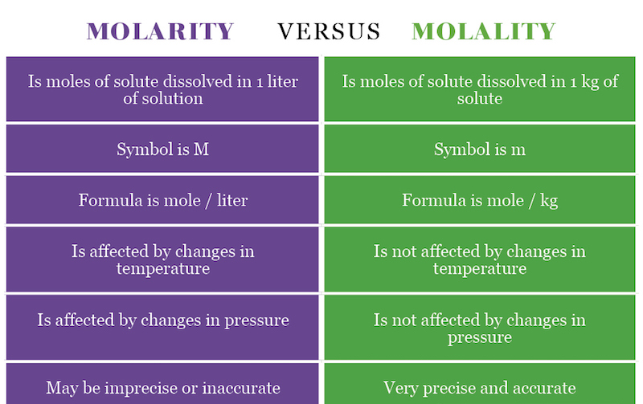
Explore - Part B: 5 minutes
Notes:
Molality vs molarity

Slide 36
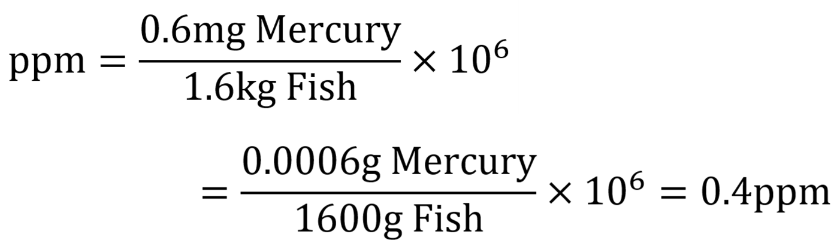
Explore - Calculating ppm & ppb
IN YOUR GROUP - WORK AT A CLASS WHITEBOARD
Record your work (take a photo and insert in these slides, redraw it in your notes etc)
Health Canada’s guideline for maximum Mercury in fish is 0.5ppm. When a 1.6kg salmon was tested, it was found to contain 0.6mg of Mercury. Is this salmon safe to eat?
Yes, it is safe to eat.

Slide 37
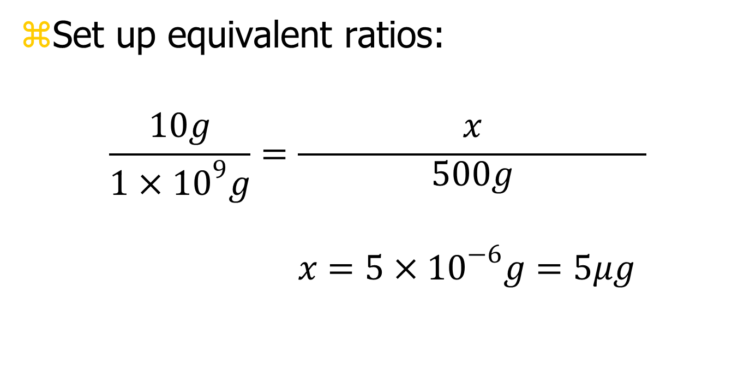
Explore - Calculating ppm & ppb
2. In Ontario, drinking water should have less than 10 ppb of lead in it. What is the maximum amount of lead allowed in a 500 mL bottle of water?
1mL of water = 1g of water (using density)
Therefore 10ppb = 10g in 1,000,000,000g of water

Slide 38
Apply- Complete the questions
(m/v)%: 45g of Cobalt Chloride is dissolved in 231mL of water. What is the (m/V)% Concentration of the solution? Ans: Percent = m/v x 100 = 45g/231ml x 100 = 19%
(m/m)%: Bronze medals in the 2018 PyeongChang Olympics had a mass of 493g. If each bronze medal contained about 435g of Copper, what is the (m/m)% of Copper in the bronze medal? Ans: Percent = m/m x 100 = 435g/493ml x 100 = 88.2%
(v/v)%: A 300mL bottle of wine contains 35mL of alcohol. What is the (v/v)%? Ans: Percent = v/v x 100 = 35ml/300ml x 100 = 12%
(v/v)%: A water sample is taken from a river to test for pollution. It must be diluted to 2% by volume of its original amount. If you have a 30mL sample, how much water must you add to get to this desired concentration? Ans: Percent = v/v x 100 -> 2% = 30ml/total volume x 100 Rearrange -> Total volume = 1500ml. Amount to add = total- original volume = 1500ml-30ml = 1470 ml added
ppm/ppb: 3mg of a dangerous chemical is found In 300 L of water. What is its concentration in ppm? Ppm = 0.003g/300000g x 10⁶ = 0.01 ppm

Slide 39
Apply- Complete the questions
Work at the board for the next few slides. Insert photos of your work and compare to answers after attempting. Show all your work! Include formulas, conversions, units, etc.
How many moles of sucrose are dissolved in 250 mL of solution if the solution concentration is 0.150 M?
Ans: Convert to L = 250 mL × 1 L 1000 mL = 0.25 L
M = n/V
0.150 M = n
0.25 L
n = 0.038 mol

Slide 40
Apply- Complete the questions
Work at the board for the next few slides. Insert photos of your work and compare to answers after attempting. Show all your work! Include formulas, conversions, units, etc.
2) What is the molarity of a solution of HNO3 that contains 12.6 grams HNO3 in 1.0 L of solution?
Answer: n = m/ MM
n of HNO3 = 12.6 g HNO3
63.0 g HNO3
n = 0.200 mol HNO3
0.150 M = n
0.25 L
n = 0.038 mol
M = n/V
M = 0.200 mol HNO3
1.0 L
M = 0.200 M
∴ the molarity of the solution is 0.200 M

Slide 41
Part 5: Beyond the course extensions
{optional}

